Slide 1
Bachelor Of Engineering In Information Technology Semester Three, Second Year(Odd semester) 14th July 2025 to 26th November 2025
Padre Conceicao College of Engineering
Verna Goa 403722 India

Slide 2
App Development
SEC-241
29th July 2025

Slide 3
UNIT 1 :Cascading Style Sheets Refer Web Technologies: HTML, Javascript, PHP, Java, JSP, ASP.NET, XML and AJAX, Black Book; Publisher: Dreamtech Press(2015) ; ISBN: 978-81-7722-997-4
Sr.No | Title
1 | Need for CSS
2 | basic syntax and structure of CSS
3 | using CSS
4 | background images
5 | colors and properties
6 | manipulating texts
7 | using fonts
8 | borders and boxes
9 | margins
10 | padding lists
11 | positioning using CSS
12 | Overview and features of CSS3.

Slide 4
Need for CSS(Cascading Style Sheets)
CSS are text files that contain one or more rules in the form of property/value pairs to determine how elements in a Web page should be displayed. They were developed with the aim to create the structure ,look and feel of a Web page but the elements present on the Web page are handled separately.CSS deals with all the style-related aspects important to create a Web page.W3C(World Wide Web Consortium ) has developed some specifications(or rules) to create and use style sheets. These specifications are called as the CSS specifications. The two versions of CSS specifications,CSS1 and CSS2.After the introduction of CSS,HTML elements that purely deal with style-related aspects, such as <u>,<centre>, and <strike> have been deprecated.W3C has recommended that in place of these HTML elements, their replacements should be used in CSS.

Slide 5
Basic syntax and structure of CSS
The syntax of CSS is slightly different from that of HTML. In contrast to the angle brackets (< and >),equal signs, and quotation marks found in the HTML syntax, the CSS contains curly braces, colons, and semicolons. The syntax of a CSS rule is as follows:
Selector{property1:property1-value;property2:property2-value;property3:property3-value…..}
Selector is the element that the rule defines
Property1, property2, property3 are the properties(attributes)defined
for that element
property1-value, property2-value, property3-value are values assigned to these properties
The portion of the syntax enclosed within curly braces is termed as declaration.

Slide 6
Using CSS
Using the preceding CSS rule syntax, we can create a CSS rule to set three background properties ( background-color, background-image, background-repeat ) for the <body> element in 3 declarations, as follows:
body{background-color:#0000ff; background-image:url(C:\Image.jpg); background-repeat: repeat-x}
You can set these 3 properties in one declaration by separating them with spaces, using the shorthand CSS property named background ,as follows:
body{ background:#0000ff url(C:\Image.jpg) repeat-x }

Slide 7
You can create cascading styles in a Web page in four ways:
Using inline styles
Using external style sheets
Using internal style sheets
Using style classes

Slide 8
Attributes of the <style> Element
Sr.No | Attribute | Description
1 | dir | Gives the direction to directionally neutral text. You can set this attribute to ltr for left to right text direction or rtl for right to left text direction.
2 | disabled | Specifies that the styles should not be applied initially. This attribute is a standalone attribute meaning that it is specified without assigning it a value.
3 | lang | Indicates base language used for the element
4 | media | Sets the media for style sheet definitions (multiple destinations are specified by separating each pair of destinations by a comma).You can set this attribute to screen (default value for the attribute),print , projection , braille , speech, or all
5 | title | Allows the browser to build a menu of alternative style sheets. You can set this attribute to an alphanumeric value.
6 | type | Specifies an essential attribute, which indicates the MIME type of the <style> element content. You can set this attribute to either text / css or text / javascript

Slide 9
Inline styles
In the Inline Styles method, style for an HTML element is specified using its style attribute.
Inline styles are useful when you want to define specific styles for individual elements present on a Web page.

Slide 10
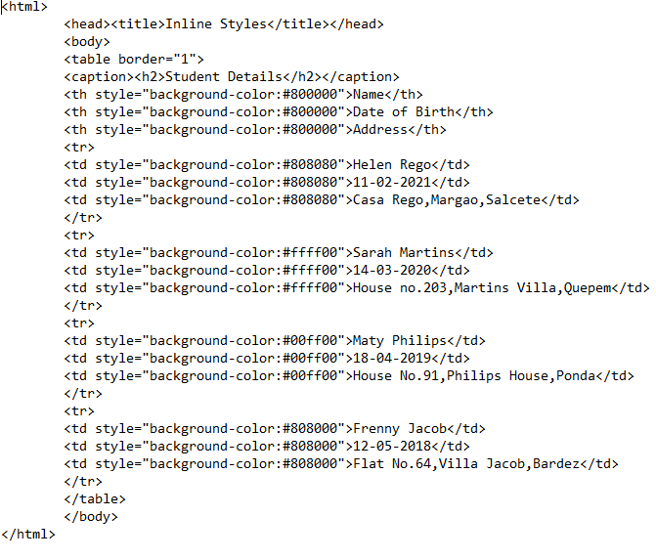
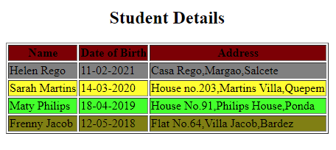
Inline styles
InlineStyles.html
output

Slide 12
External style sheets
An external style sheet is a separate document that contains only CSS rules.
An external style sheet has a .css extension.
External style sheets are used to apply uniform styles to all the Web pages.
For example, let's assume that you are creating a website that contains more than one Web page and you want the same look and feel for same type of HTML elements in all the Web pages. In such a situation, you can first create all the required CSS rules in an external style sheet and then link it to all the Web pages of the website.

Slide 13
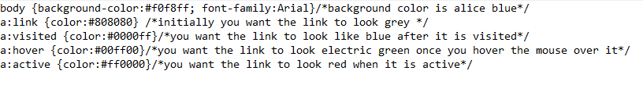
Creating External style sheet
You can create an external style sheet by creating a new ,blank document in a text editor, such as Notepad, and create your styles in the document. After creating your styles, you need to save the document with .css extension.
After creating an external style sheet, you can use the styles added to the style sheet, in an HTML document. To do so, you need to link the style sheet to the HTML document (web page) by using the <link> element.
Style.css

Slide 14
Style.css

Slide 15
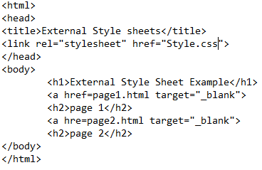
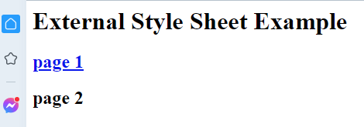
Linking an HTML Document to an External Style sheet
You can link your Web page to an external style sheet by setting the href attribute of the <link> element to the name of the style sheet. The <link> element is added inside the <head> element of the HTML document.
ExternalStyleSheets.html
output

Slide 16
ExternalStyleSheets.html

Slide 17
Internal style sheets
Internal style sheets are not separate documents, rather they are styles, created inside an HTML document.
An internal style sheet is a set of styles that is created as a part of an HTML document.
These style sheets are useful when you want to apply similar styles to all the elements present on a Web page.
Internal style sheets are created using the <style> element that is added inside the <head> element of the HTML document.

Slide 18
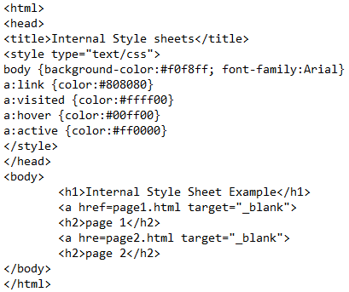
InternalStyleSheets.html

Slide 19
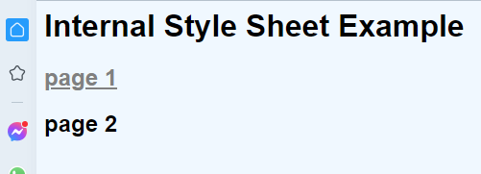
Internal style sheets
InternalStyleSheets.html
Output

Slide 20
Using style classes
In style classes method, you can create styles in the form of style classes in external or embedded style sheets. To apply a style defined in a style class to an HTML element, you can assign the class attribute of the HTML element to the name of the style class. You can create two types of style classes : universal and element specific. A universal style class starts with a dot operator (.) followed by the class name. The syntax to define a universal style class is as follows:
<style> .class name {class definition} </style>
An element specific style class starts with the element name, followed by a dot operator, which is followed by the class name. The syntax to define an element specific style class is as follows.
<style> Element name. Class name {class definition} </style>

Slide 21
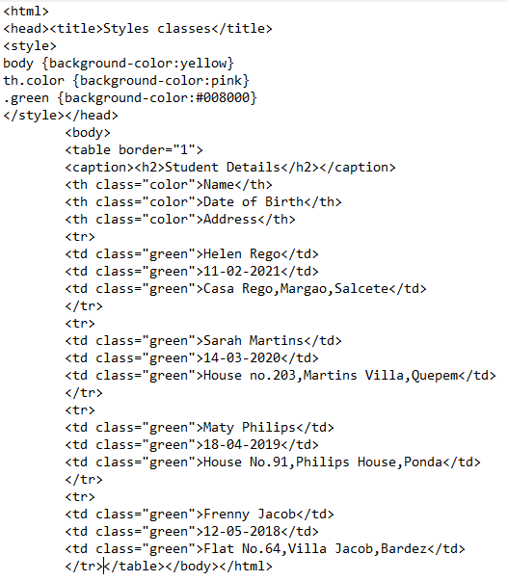
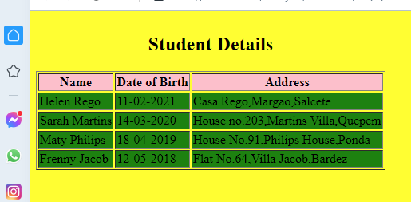
Using style classes
StyleClasses.html
output

Slide 22
StyleClasses.html

Slide 23
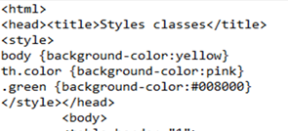
StyleClasses.html

Slide 24
Multiple styles
Multiple styles can be defined by using the different methods to implement CSS. For this reason ,the use of several external style sheets results in cascading the styles, which is a combination of styles for various HTML elements. If multiple styles affect the same element, only the last one is used. You can link the external style sheets to the document as follows:
<LINK rel=stylesheet type=“text/css” href=“style1.css”>
<LINK rel=stylesheet type=“text/css” href=“style2.css”>
<LINK rel=stylesheet type=“text/css” href=“style3.css”>

Slide 25
If multiple conflicting styles are found in the external style sheets, the CSS recommendations allow users to select among several alternative style sheets using the rel attribute of the <STYLE> tag, which is combined with the TITLE attribute to select them by name.
<LINK rel=“alternate stylesheet” type=“text/css” href=“style1.css” title=“style1”>
<LINK rel=“alternate stylesheet” type=“text/css” href=“style2.css” title=“style2”>
<LINK rel=stylesheet type=“text/css” href=“style2.css”>
Multiple styles are included in a page by using the various possible inclusion methods.
The style closest to the content is applied when some conflict appears among styles.

Slide 26
Background property
The background property is a shorthand property for
background-color
background-image
background-position
background-size
background-repeat
background-origin
background-clip
background-attachment

Slide 27
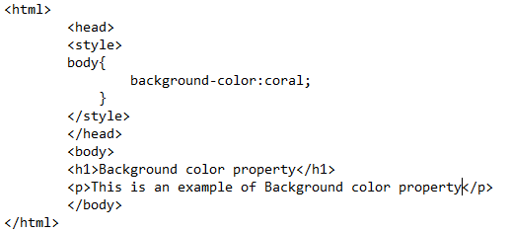
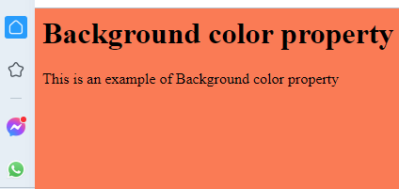
Background-color property
BackgroundColor.html
output

Slide 28
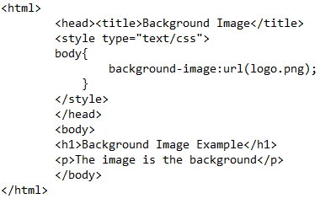
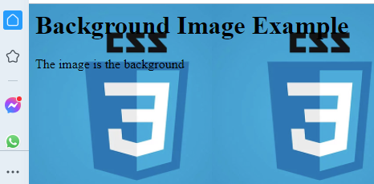
Background image property
The background-image property specifies the image URL for the image logo.png in the format url(fileLocation)
BackgroundImage.html
output

Slide 29
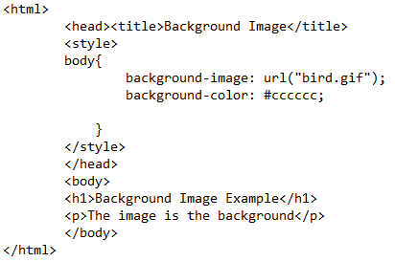
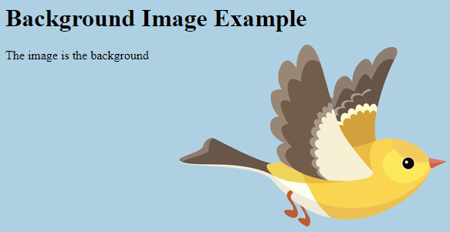
Background image property
Backgroundgif.html
output

Slide 30
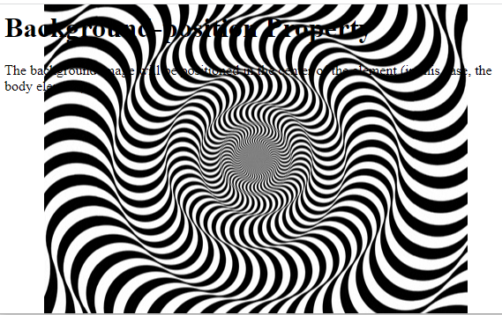
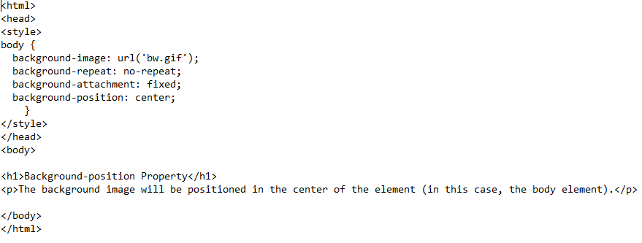
background-position property
BackgroundPosition.html
output

Slide 31
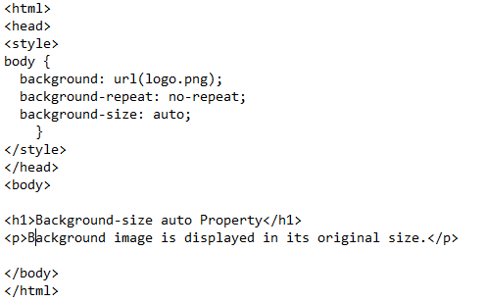
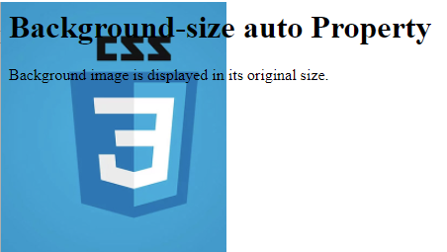
background-size property
BackgroundSizeAuto.html
output

Slide 32
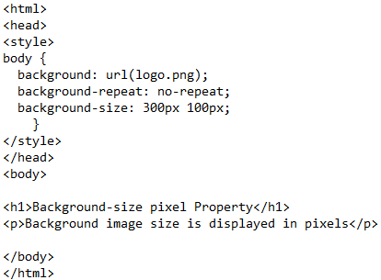
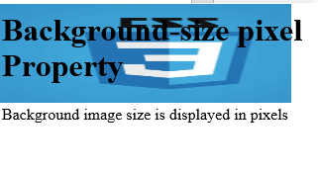
background-size pixel property
BackgroundSizePixel.html
output

Slide 33
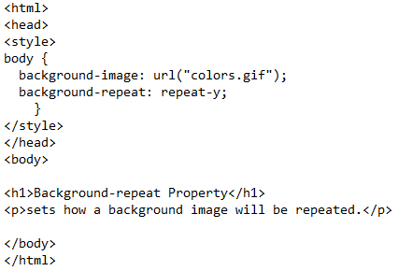

background-repeat property
BackgroundRepeat.html
output

Slide 34
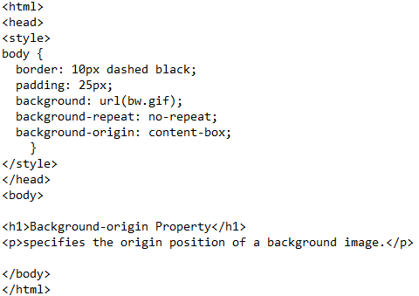

background-origin property
output
BackgroundOrigin.html

Slide 35
background-clip property
The background-clip property defines how far the background should extend within an element.
Value | Description
border-box | Default value. The background extends behind the border
padding-box | The background extends to the inside edge of the border
content-box | The background extends to the edge of the content box

Slide 36
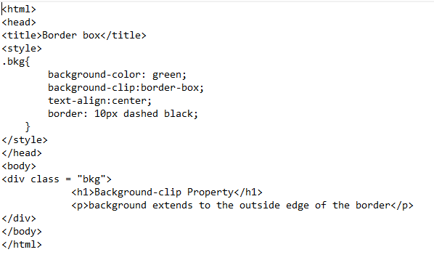
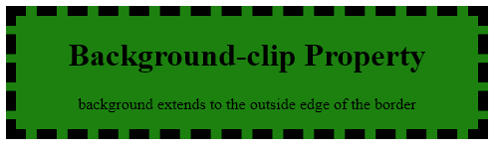
background-clip Border-Box property
BackgroundClipBorderBox.html
output

Slide 37
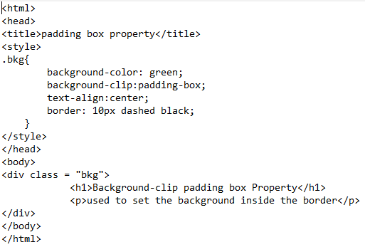
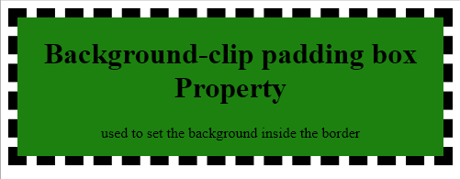
background-clip Padding-Box property
BackgroundClipPaddingBox.html
output

Slide 38
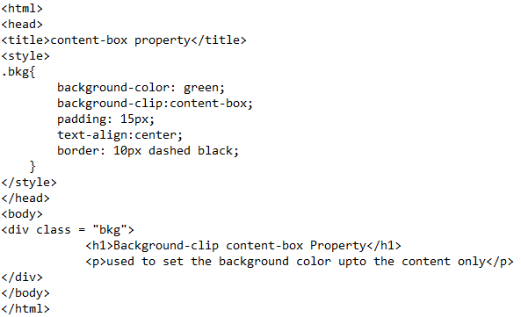
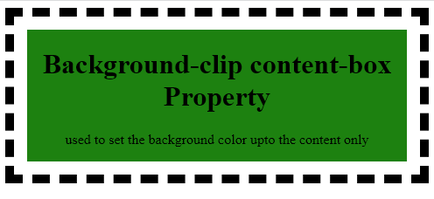
background-clip Content-Box property
BackgroundClipContentBox.html
output

Slide 39
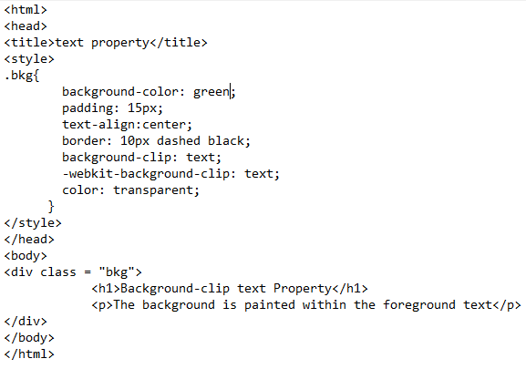
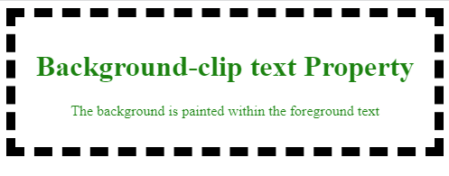
background-clip Text property
BackgroundClipText.html
output

Slide 40
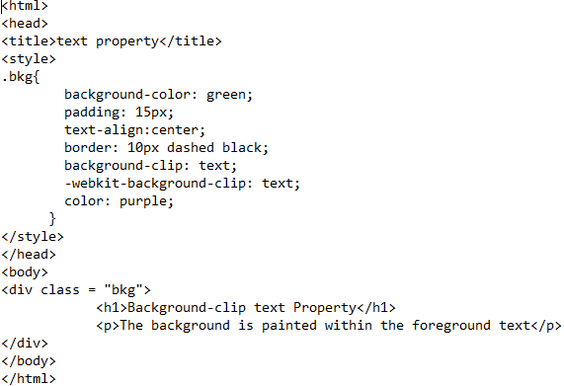
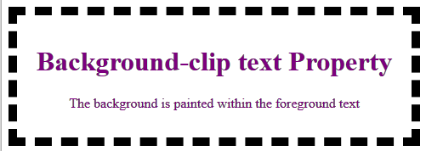
background-clip Text property
BackgroundClipText.html
output

Slide 41
background-attachment property
The background-attachment property sets whether a background image scrolls with the rest of the page, or is fixed.
Value | Description
scroll | The background image will scroll with the page. This is default
fixed | The background image will not scroll with the page
local | The background image will scroll with the element's contents

Slide 42
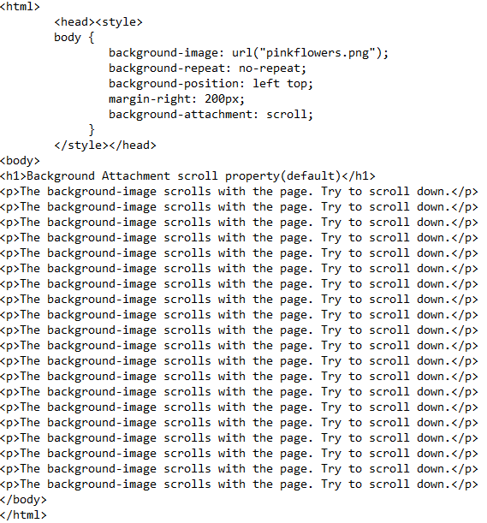
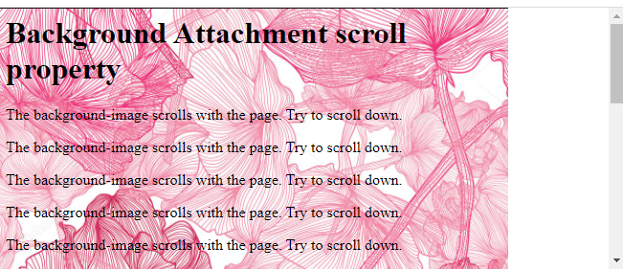
background-attachment scroll property
BackgroundAttachmentScroll.html
output

Slide 43
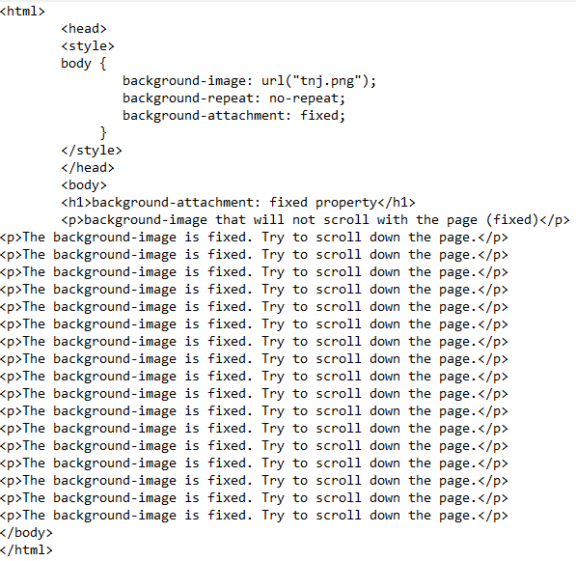
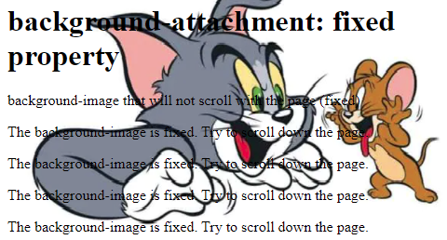
background-attachment Fixed property
BackgroundAttachmentFixed.html
output

Slide 44
background-attachment local property
When there is only a single scroll bar on the page, a scroll setting and a local setting behaves exactly the same because, under those circumstances, local refers to the entire space within the scrollable element. The difference between these two values comes when there are at least two scrollable areas on the page, one inside the other. The table below shows how different background-attachment value behaves when there are two scrollable areas:
Value | Outer Scroll bar | Inner scroll bar
fixed | Does not move | Does not move
scroll | moves | Does not move
local | moves | moves

Slide 45
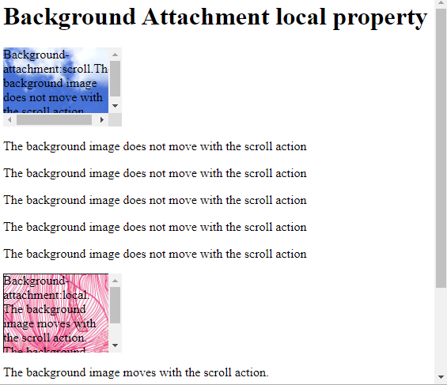
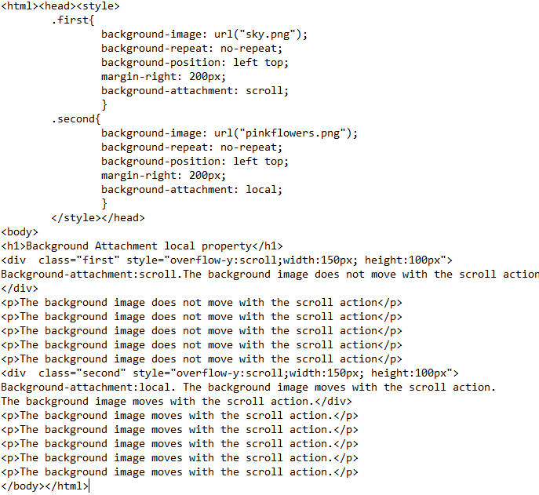
background-attachment scroll v/s local
BackgroundAttachmentLocal.html
output

Slide 46
manipulating texts
You can set following text properties of an element −
Value | Description
color | The color property is used to set the color of a text
direction | used to set the text direction.
letter-spacing | used to add or subtract space between the letters that make up a word.
word-spacing | used to add or subtract space between the words of a sentence.
text-indent | used to indent the text of a paragraph.
text-align | used to align the text of a document.
text-decoration | used to underline, over line, and strikethrough text.
text-transform | used to capitalize text or convert text to uppercase or lowercase letters.
white-space | used to control the flow and formatting of text.
text-shadow | used to set the text shadow around a text.

Slide 47
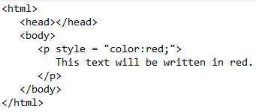

text color
The following example demonstrates how to set the text color. Possible value could be any color name in any valid format.
textcolor.html
output

Slide 48
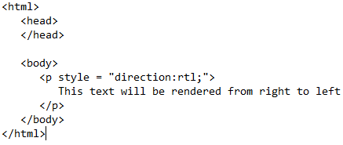
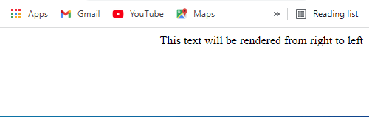
text direction
The following example demonstrates how to set the direction of a text. Possible values are ltr or rtl.
textdirection.html
output

Slide 49
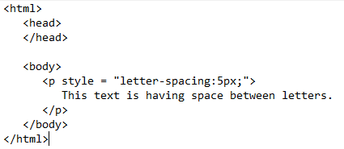
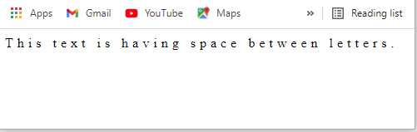
letter-spacing
The following example demonstrates how to set the space between characters. Possible values are normal or a number specifying space..
textWordSpace.html
output

Slide 50
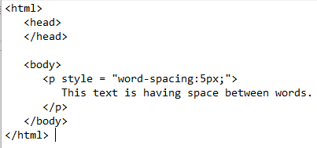
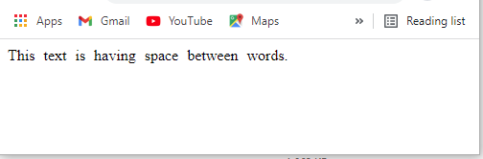
word-spacing
The following example demonstrates how to set the space between words. Possible values are normal or a number specifying space.
textWordSpace.html
output

Slide 51
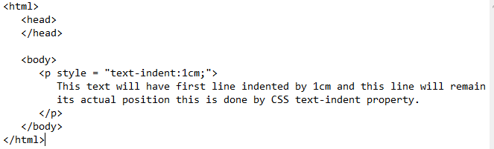
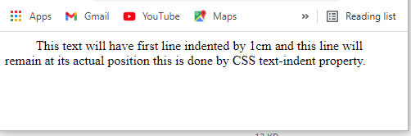
text-indent
The following example demonstrates how to indent the first line of a paragraph. Possible values are % or a number specifying indent space.
textIndent.html
output

Slide 52
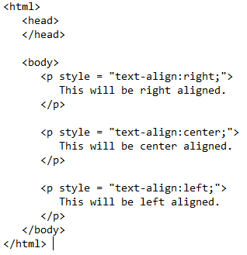

text-align
The following example demonstrates how to align a text. Possible values are left, right, center, justify.
textAlign.html
output

Slide 53


text-decoration property
textdecoration.html
output

Slide 54


text-decoration-line property
output
textdecoration.html

Slide 55


text-decoration-color
output
textdecorationColor.html

Slide 56


text-decoration-style property
textdecorationStyle.html
output

Slide 57


text-decoration-thickness property
textdecorationThickness.html
output

Slide 58


text-indent property
output
textMultipleIndent.html

Slide 59


text-shadow property
output
textShadow.html

Slide 60


text-transform
output
textTransform.html

Slide 61


white-space
output
textWhiteSpace.html

Slide 62
Font property
In HTML you can change the size, style and family of fonts using various CSS properties.CSS provides the following properties to perform different tasks that can be grouped to their functionalities related to fonts and text.
Font-family
Font-size
Font-size-adjust
Font-stretch
Font-style
Font-variant
Font-weight
font

Slide 63
Generic Font Families
In CSS there are five generic font families:
Serif fonts have a small stroke at the edges of each letter. They create a sense of formality and elegance.
Sans-serif fonts have clean lines (no small strokes attached). They create a modern and minimalistic look.
Monospace fonts - here all the letters have the same fixed width. They create a mechanical look.
Cursive fonts imitate human handwriting.
Fantasy fonts are decorative/playful fonts

Slide 64

Difference Between Serif and Sans-serif Fonts

Slide 65
The CSS font-family Property
In CSS, we use the font-family Property to specify the font of the text. If the font name is more than one word, it must be in quotation marks, like: "Times New Roman".
The font-family Property should hold several font names as a “fallback” system, to ensure maximum compatibility between browsers/operating systems.
Start with the font you want, and end with a generic family (to let the browser pick a similar font in the generic family, if no other fonts are available). The font names should be separated with comma.

Slide 66


The Font-family Property
fontFamily.html
output

Slide 67
The Font-size Property
The Font-size Property sets the size of the text. You should not use font size adjustments to make paragraphs look like headings, or headings look like paragraphs. Always use the proper HTML tags, like <h1> - <h6> for headings and <p> for paragraphs. The font-size value can be an absolute, or relative size.
1. Absolute size:
Sets the text to a specified size
Does not allow a user to change the text size in all browsers (bad for accessibility reasons)
Absolute size is useful when the physical size of the output is known
2. Relative size:
Sets the size relative to surrounding elements
Allows a user to change the text size in browsers

Slide 68


Set Font Size With Pixels
Setting the text size with pixels gives you full control over the text size
fontSize.html
output

Slide 69
Set Font Size With em
To allow users to resize the text (in the browser menu), many developers use em instead of pixels.
1em is equal to the current font size.
The default text size in browsers is 16px.So, the default size of 1em is 16px.
The size can be calculated from pixels to em using this formula: pixels/16=em

Slide 70


Set Font Size With em
fontSizeEm.html
output

Slide 71

Use a Combination of Percent and Em
fontSizePercentEm.html

Slide 72

Use a Combination of Percent and Em
output

Slide 73
The Font-size-adjust Property
The Font-size-adjust Property gives you better control of the font size when the first selected font is not available. When a font is not available, the browser uses the second specified font. This could result in a big change for the font size. To prevent this, use the Font-size-adjust Property. The font-size-adjust property is used to change the aspect value of the text on a web page.
All fonts have an "aspect value" which is the relation between the font height of a lowercase letter and the actual height of the font. This ratio is also known as x-height . When the browser knows the "aspect value" for the first selected font, the browser can figure out what font-size to use when displaying text with the second choice font.

Slide 74
The Font-size-adjust Property
For example, the aspect value of the Verdana font is 0.58, which means that when the font size of 100px, the height of a character written in lowercase of Verdana font is 58 pixels.
In the case of Times New Roman font, when the font size is 100px, its x-height is 46 pixels. This means that the aspect value of the Times New Roman font is 0.46.You can increase or decrease the height of the font by modifying its aspect value.

Slide 75

The Font-size-adjust Property
fontSizeAdjust.html

Slide 76

The Font-size-adjust Property
output

Slide 77
The font-stretch property
The font-stretch property allows you to make text narrower (condensed) or wider (expanded).It is used to change the width of a font. You can do this by specifying the following property values.
Value | Description
ultra-condensed | Makes the text as narrow as it gets
extra-condensed | Makes the text narrower than condensed, but not as narrow as ultra-condensed
condensed | Makes the text narrower than semi-condensed, but not as narrow as extra-condensed
semi-condensed | Makes the text narrower than normal, but not as narrow as condensed
normal | Default value. No font stretching
semi-expanded | Makes the text wider than normal, but not as wide as expanded
expanded | Makes the text wider than semi-expanded, but not as wide as extra-expanded
extra-expanded | Makes the text wider than expanded, but not as wide as ultra-expanded
ultra-expanded | Makes the text as wide as it gets

Slide 78


The font-stretch property
fontStretch.html
output

Slide 79


The font-style property
The font-style property specifies the font style for a text.
fontStyle.html
output

Slide 80
The font-variant property
In a small-caps font, all lowercase letters are converted to uppercase letters. However, the converted uppercase letters appears in a smaller font size than the original uppercase letters in the text. The font-variant property specifies whether or not a text should be displayed in a small-caps font.

Slide 81


The font-variant property
fontVariant.html
output

Slide 82
The font-weight property
The font-weight property is used to specify the weight of the font, such as the font boldness or thickness.
Font weight is a term used to signify the extent of boldness or thickness assigned to a character, when a particular font is applied to it.
For example, the font weight of a character written in the Cooper Black font , A, is more than the same letter , A , written in the Arial font.

Slide 83
values of the font-weight property
Values | Description
normal | Defines normal characters. This is default
bold | Defines thick characters
bolder | Defines thicker characters
lighter | Defines lighter characters
100 | Represents the thin font
200 | Represents the extra light font
300 | Represents the light font
400 | Represents the normal font
500 | Represents the medium font
600 | Represents the semi bold font
700 | Represents the bold font
800 | Represents the extra bold font
900 | Represents the black (heavy) font

Slide 84


The font-weight property
fontWeight.html
output

Slide 85


Border Property
BorderColor.html
output

Slide 86
Border Image Property
Border Image Property allows you to specify an image to be used as the border around an element.
The border-image property is a shorthand property for:
Border-image-source
Border-image-slice
Border-image-width
Border-image-outset
Border-image-repeat
Omitted values are set to their default values.

Slide 87
Border Image Property
Value | Description
Border-image-source | The path to the image to be used as a border
Border-image-slice | How to slice the border image
Border-image-width | The width of the border image
Border-image-outset | The amount by which the border image area extends beyond the border box
Border-image-repeat | Whether the border image should be repeated, rounded or stretched

Slide 88

Border-image-source
BorderImage.html

Slide 89

Border-image-source

Slide 90

Border-image-slice
BorderImageSlice.html

Slide 91

Border-image-slice

Slide 92

Border-image-width
BorderImageWidth.html

Slide 93

Border-image-width

Slide 94

Border-image-outset
BorderImageOutset.html

Slide 95

Border-image-outset

Slide 96

Border-image-repeat
BorderImageRepeat.html

Slide 97

Border-image-repeat

Slide 98
margins
The CSS margin properties are used to create space around elements, outside of any defined borders.
With CSS, you have full control over the margins. There are properties for setting the margin for each side of an element (top, right, bottom, and left).
CSS has properties for specifying the margin for each side of an element:
Margin-top
Margin-bottom
Margin-right
Margin-left

Slide 99
margins
All the margin properties can have the following values:
auto - the browser calculates the margin
length - specifies a margin in px, pt, cm, etc.
% - specifies a margin in % of the width of the containing element
inherit - specifies that the margin should be inherited from the parent element
Negative values are allowed.

Slide 100

margins
margin.html

Slide 101

margins

Slide 102

Margin top
margintop.html

Slide 103


Slide 104

Margin-bottom
marginbottom.html

Slide 105

Margin-bottom

Slide 106

Margin left
marginleft.html

Slide 107

Margin left

Slide 108

Margin right
marginright.html

Slide 109

Margin right

Slide 110
padding
Padding is used to create space around an element's content, inside of any defined borders.
The css padding properties are used to generate space around an element's content, inside of any defined borders.
With CSS, you have full control over the padding. There are properties for setting the padding for each side of an element (top, right, bottom, and left).

Slide 111
padding
CSS has properties for specifying the padding for each side of an element:
Padding-top
Padding-right
Padding-bottom
Padding-left

Slide 112

padding
padding.html

Slide 113

padding

Slide 114

Padding bottom
paddingright.html

Slide 115

Padding bottom

Slide 116

Padding top
paddingtop.html

Slide 117

Padding top

Slide 118

Padding left
paddingleft.html

Slide 119

Padding left

Slide 120

Padding right
paddingright.html

Slide 121

Padding right

Slide 122
positioning using CSS
positioning property specifies the type of positioning method used for an element .
There are five different position values:
Static
Relative
fixed
Absolute
sticky

Slide 123
position: static
HTML elements are positioned static by default.
Static positioned elements are not affected by the top, bottom, left, and right properties.
An element with position: static is not positioned in any special way; it is always positioned according to the normal flow of the page:

Slide 124

position: static
positionStatic.html

Slide 125

position: static output

Slide 126
position: relative
An element with position: relative is positioned relative to its normal position.
Setting the top, right, bottom, and left properties of a relatively-positioned element will cause it to be adjusted away from its normal position. Other content will not be adjusted to fit into any gap left by the element.

Slide 127

position: relative
positionRelative.html

Slide 128

position: relative output

Slide 129
position: fixed
An element with position: fixed is positioned relative to the viewport, which means it always stays in the same place even if the page is scrolled. The top, right, bottom, and left properties are used to position the element.
A fixed element does not leave a gap in the page where it would normally have been located.
Notice the fixed element in the lower-right corner of the page.

Slide 130

position: fixed
positionFixed.html

Slide 131

position: fixed output

Slide 132
position: absolute
An element with position: absolute is positioned relative to the nearest positioned ancestor (instead of positioned relative to the viewport, like fixed).
If an absolute positioned element has no positioned ancestors, it uses the document body, and moves along with page scrolling.
Absolute positioned elements are removed from the normal flow, and can overlap elements.

Slide 133

position: absolute

Slide 134

position: absolute output

